Slide 1
BUSINESS DATA MANAGEMENT
CAPSTONE PROJECT
Optimization of Inventory Management for Ronak Super Market.
Name : Dhirajkumar Pachling
Roll No : 23f1002092
Email : 23f1002092@ds.study.iitm.ac.in

Slide 2

Contents
1) Executive Summary | Introduction to Business
2) Data Collection & Cleaning | Data Collection and Cleaning Steps
3) Data Analysis | Analysis done in respect to the challenges
4) Findings | Important Insights about business
5) Recommendation | Solutions / Recommendations for business

Slide 3
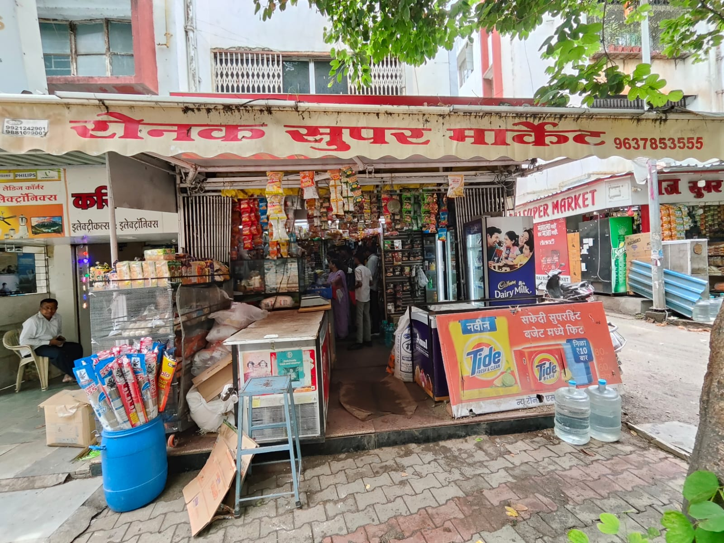

Executive Summary
The data for this project has been collected from a medium-sized Kirana Shop, established by Mr. Ramesh Choudhary in early 2015.
The store offers a diverse range of products including
Rice, oils, milk, dairy products, cereals and grains.
However, the store has been facing significant challenges related to profit margins, sales performance, and inventory management.

Slide 4

1. Data Collection & Cleaning
Data Collection: Over a period of 31 days, I visited the store daily and meticulously recorded the sales, purchase quantities, prices, and inventory levels for 10 selected items, ensuring the data collected was comprehensive and accurate.
Primary Data: The gathered information was primary and in its raw form, required significant refinement and processing to make it analyzable.
Data Cleaning and Preparation: Utilizing Google Sheets/Excel, I consolidated and cleaned the raw data, preparing it meticulously for subsequent analysis to ensure its reliability and accuracy.

Slide 5
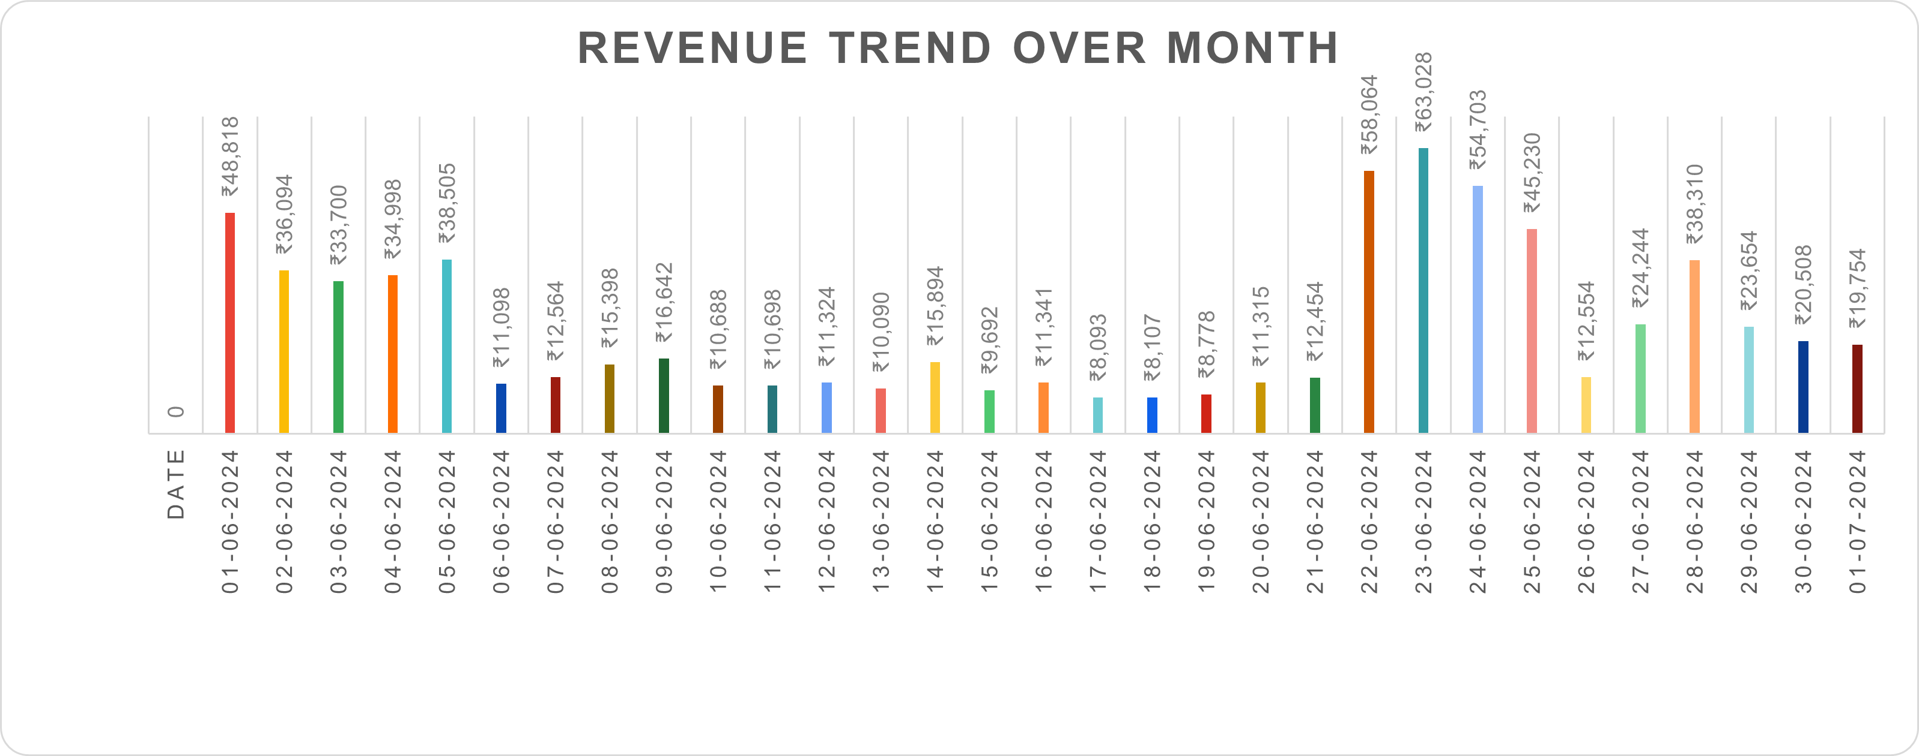
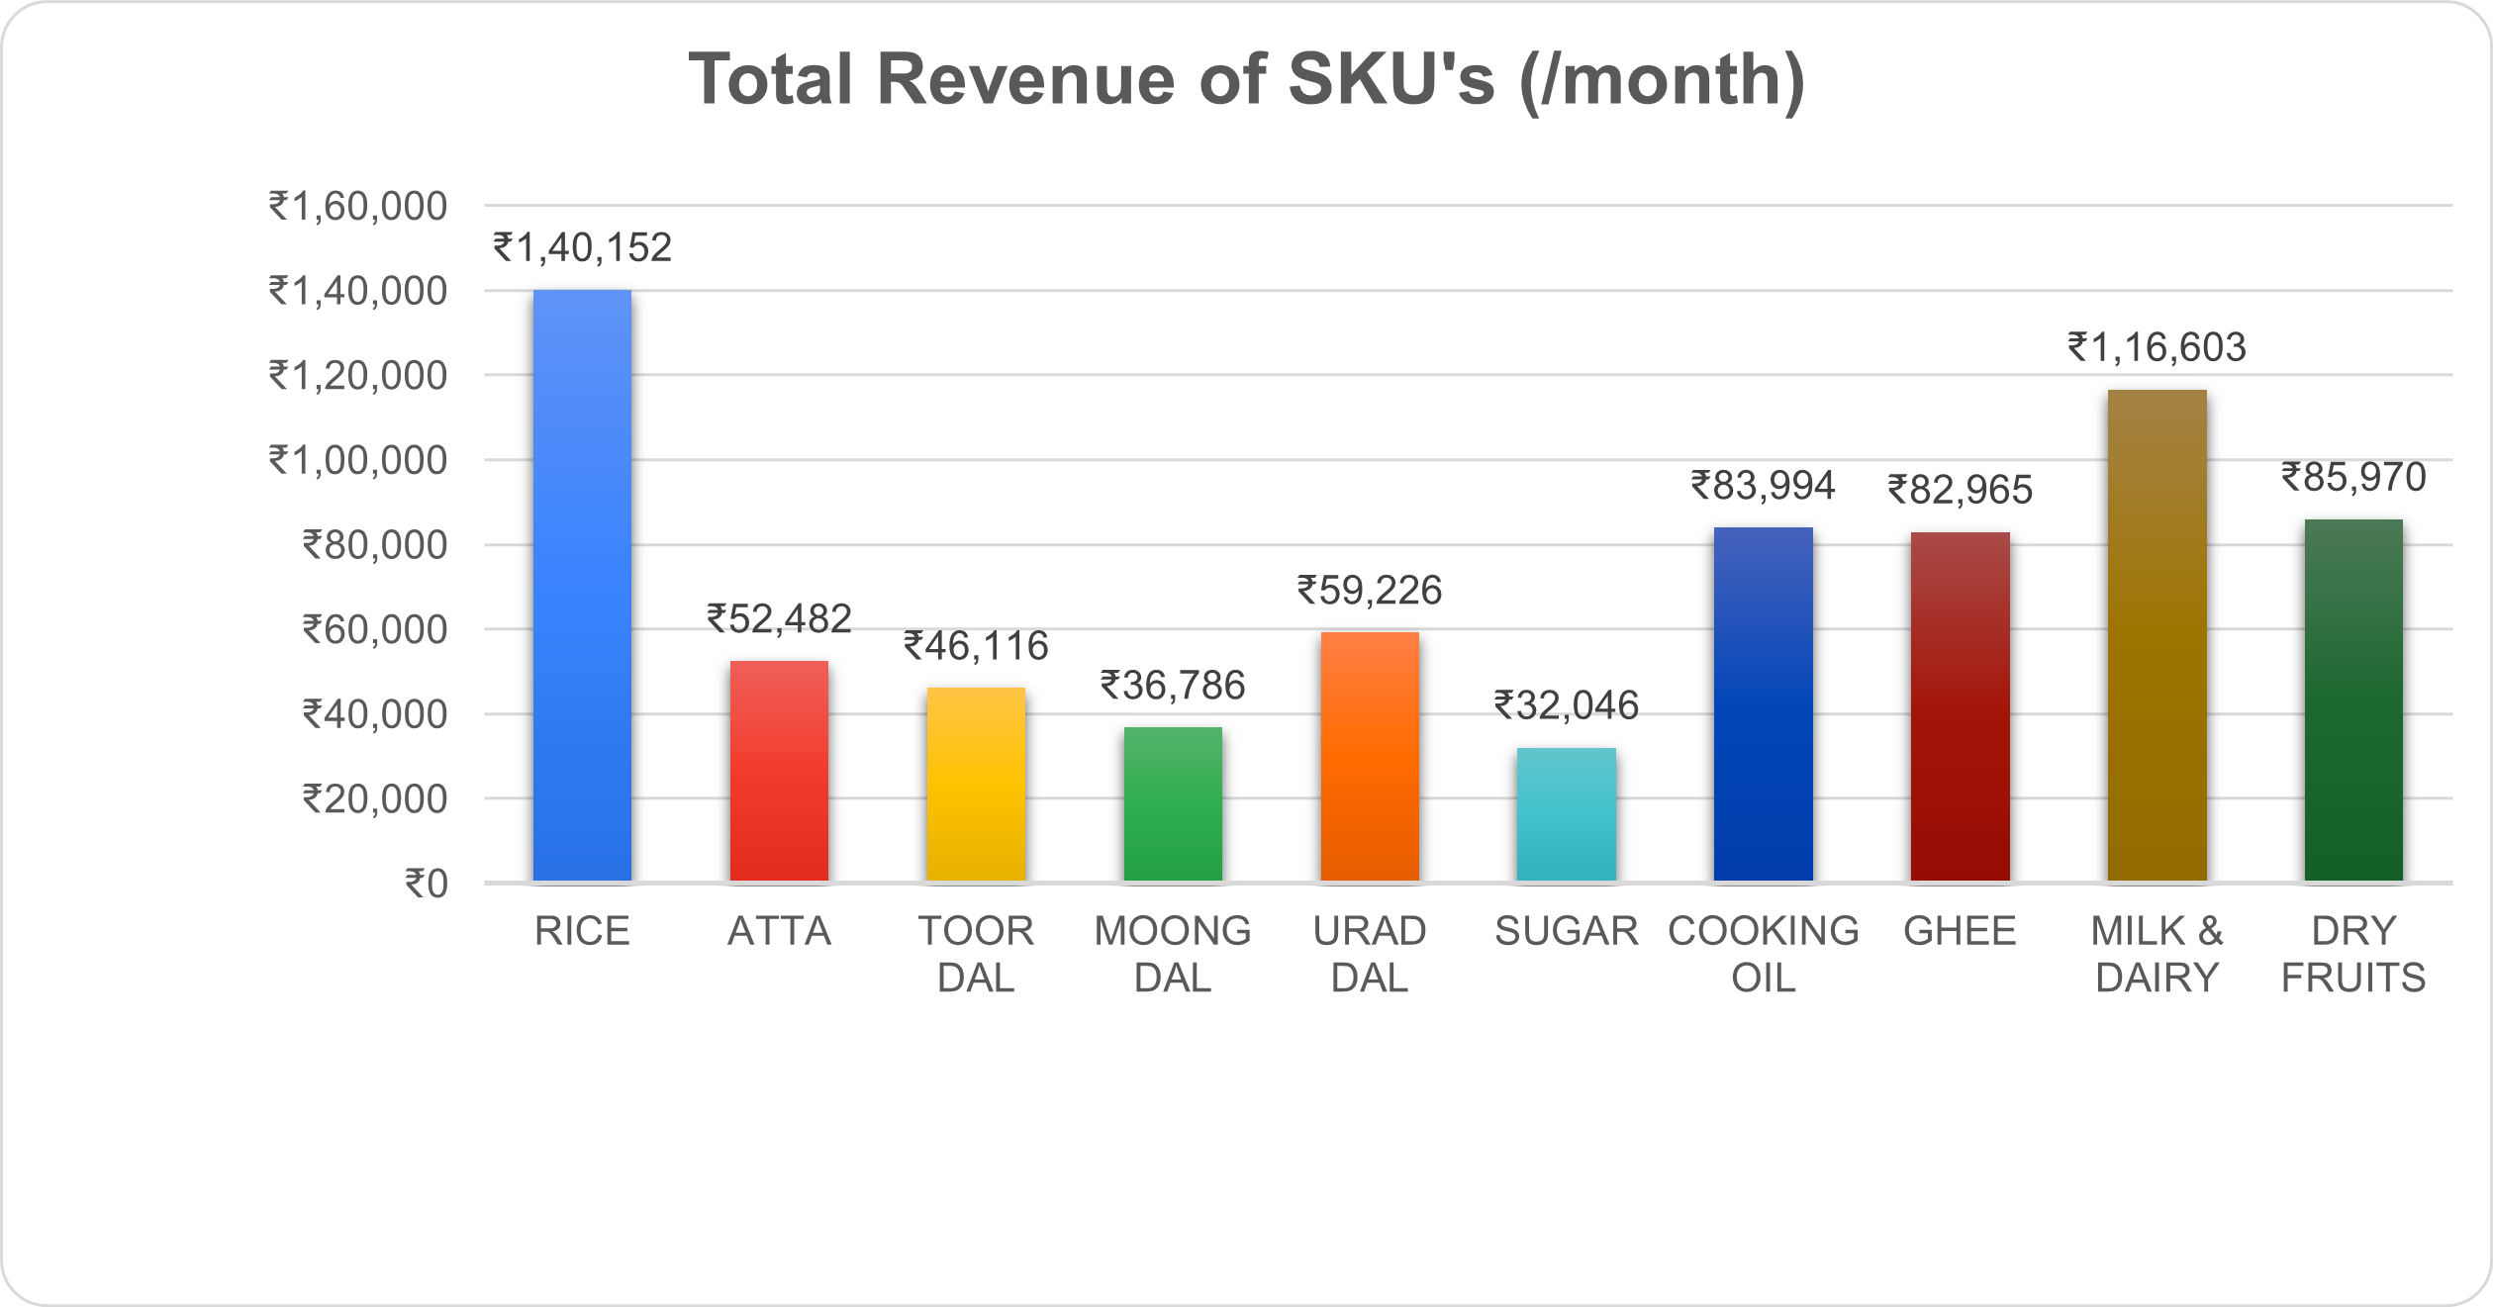
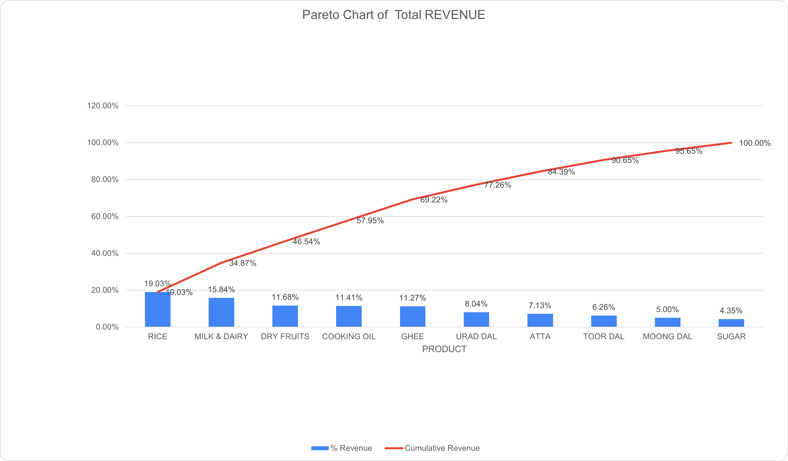

2. Data Analysis
Objective 1: Sales
High Revenue generating Days : 22th - 25th
Average daily revenue : ₹23,753
Minimum revenue : ₹8,093 (17/06/2024)
Maximum revenue : ₹63,028 (23/06/2024)
Range : ₹54,935
Rice , Milk & Dairy , Dry Fruits , Cooking Oil , Ghee and Urad Dal are the main revenue generating SKU (appox. 77.26 %)

Slide 6
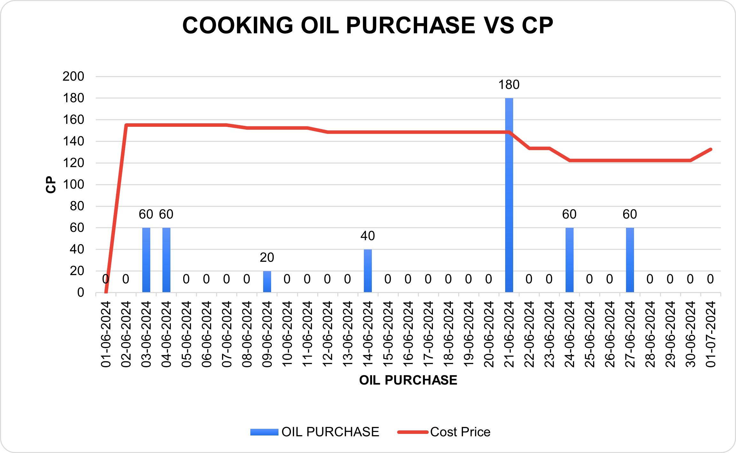
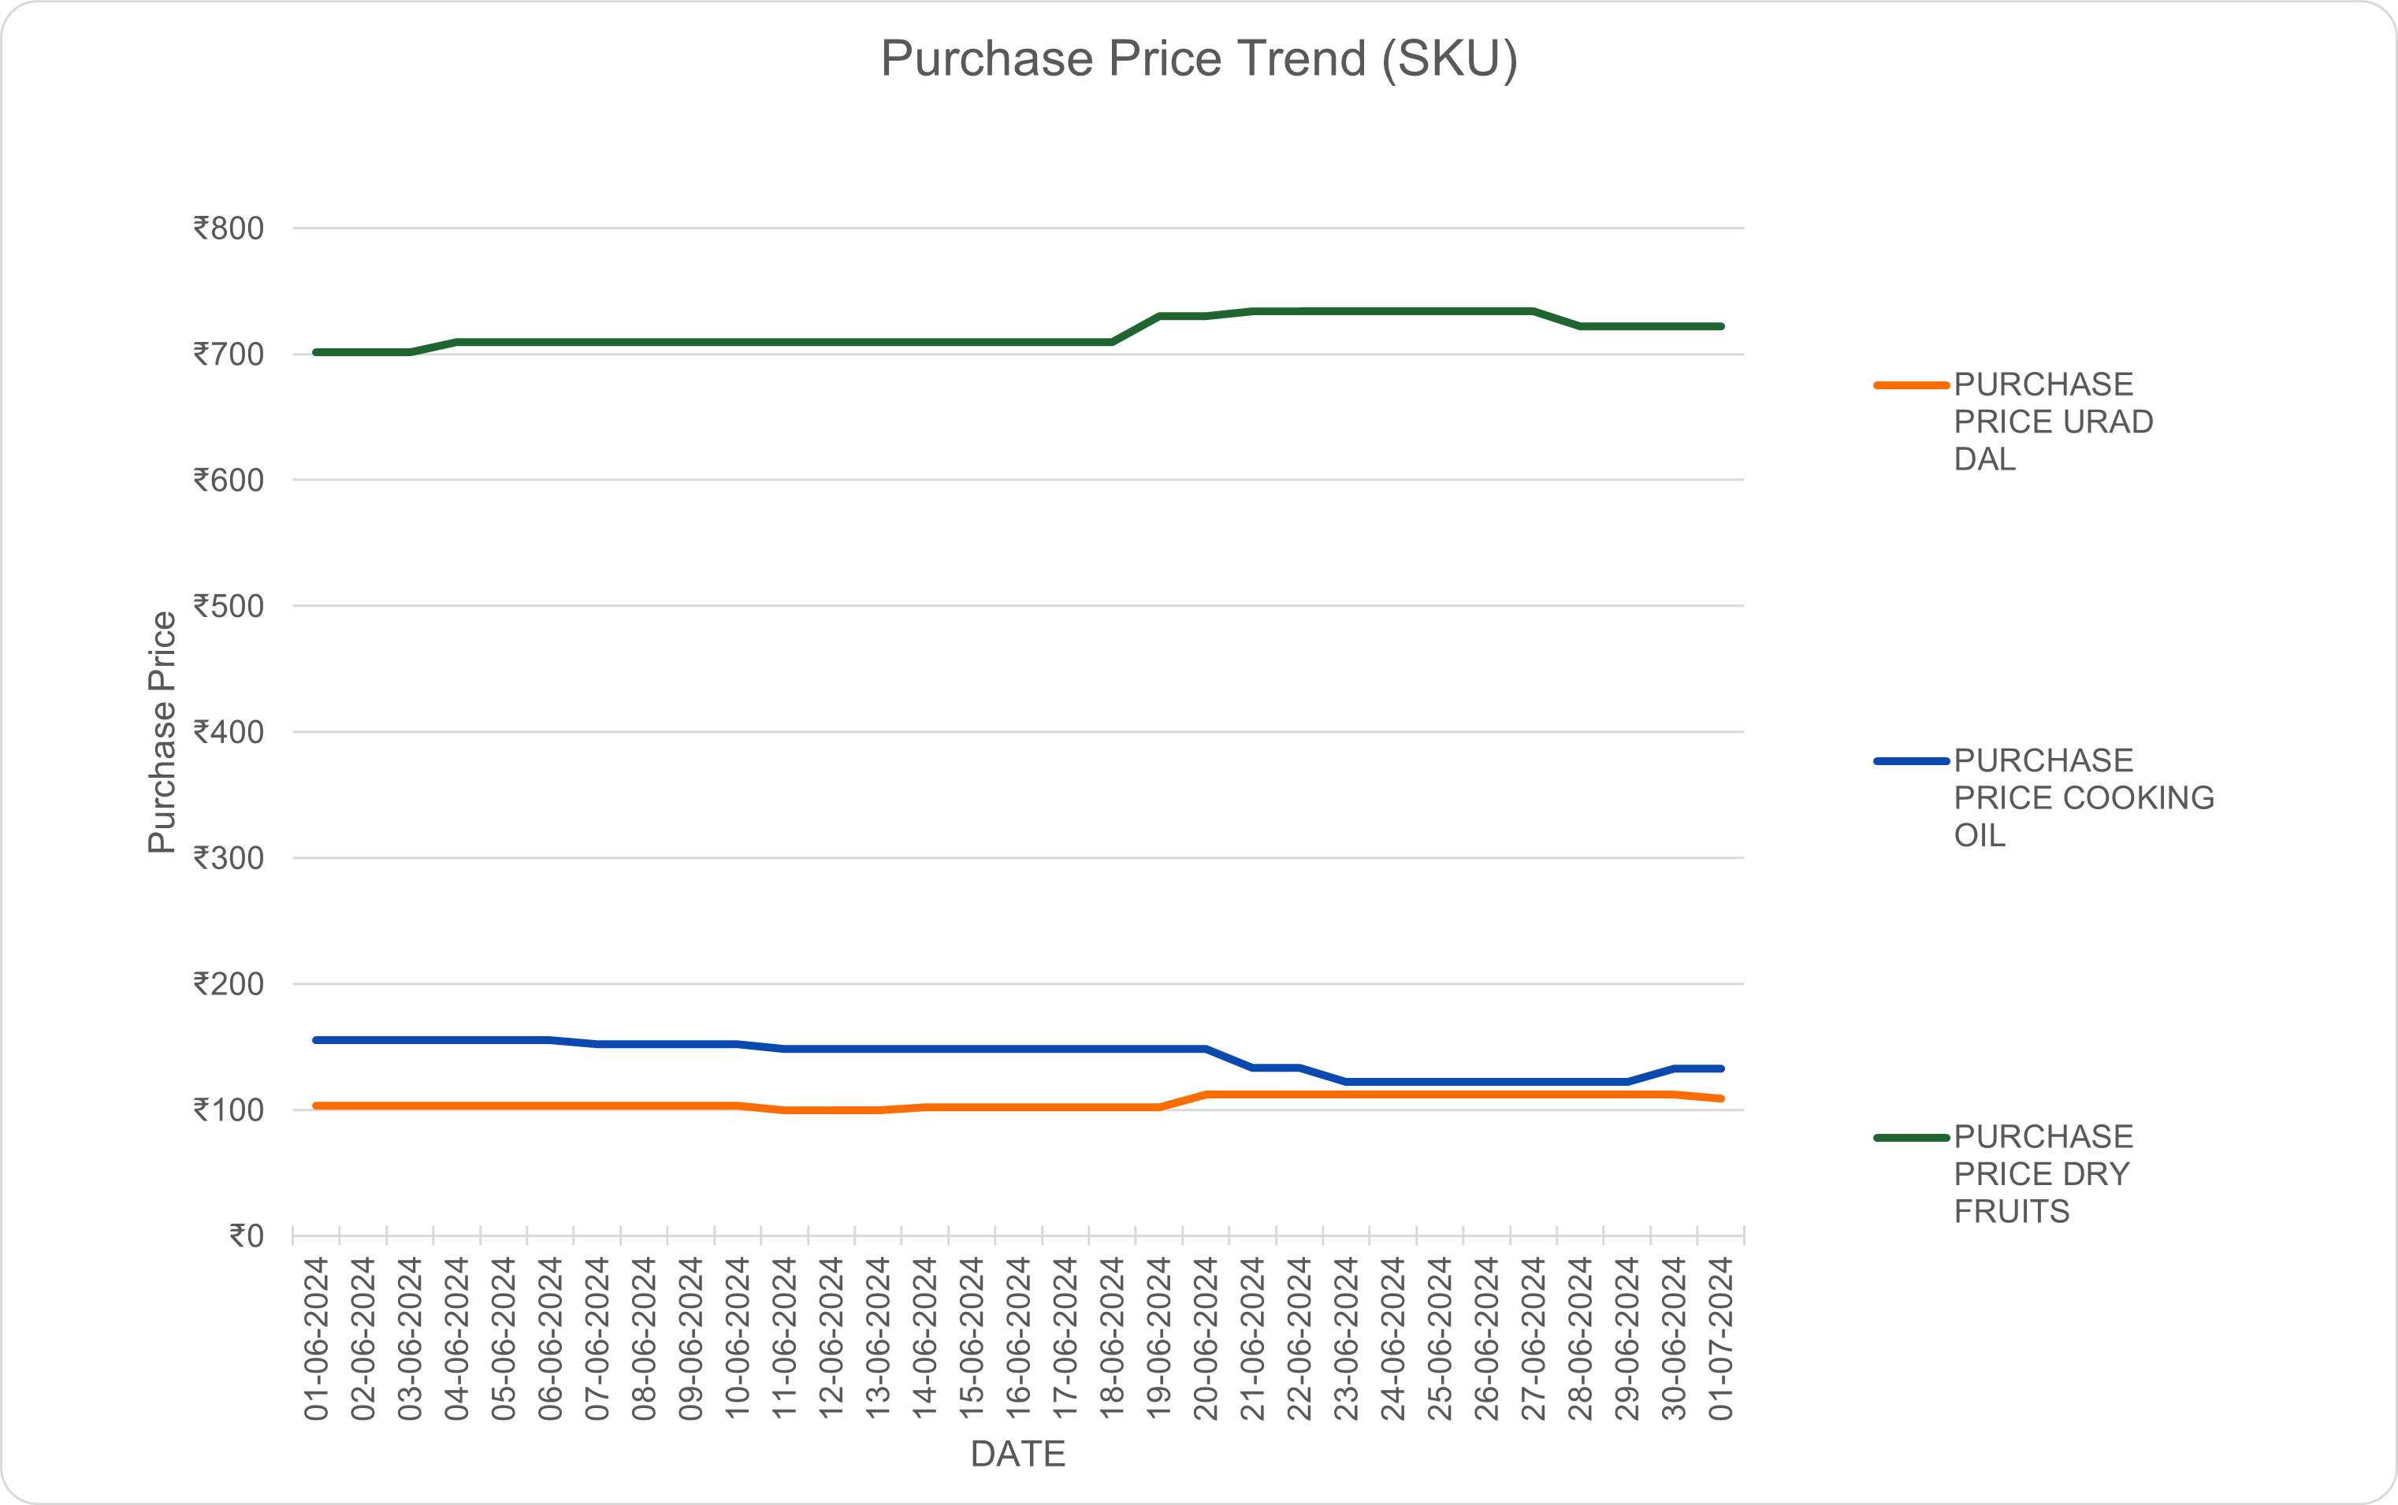
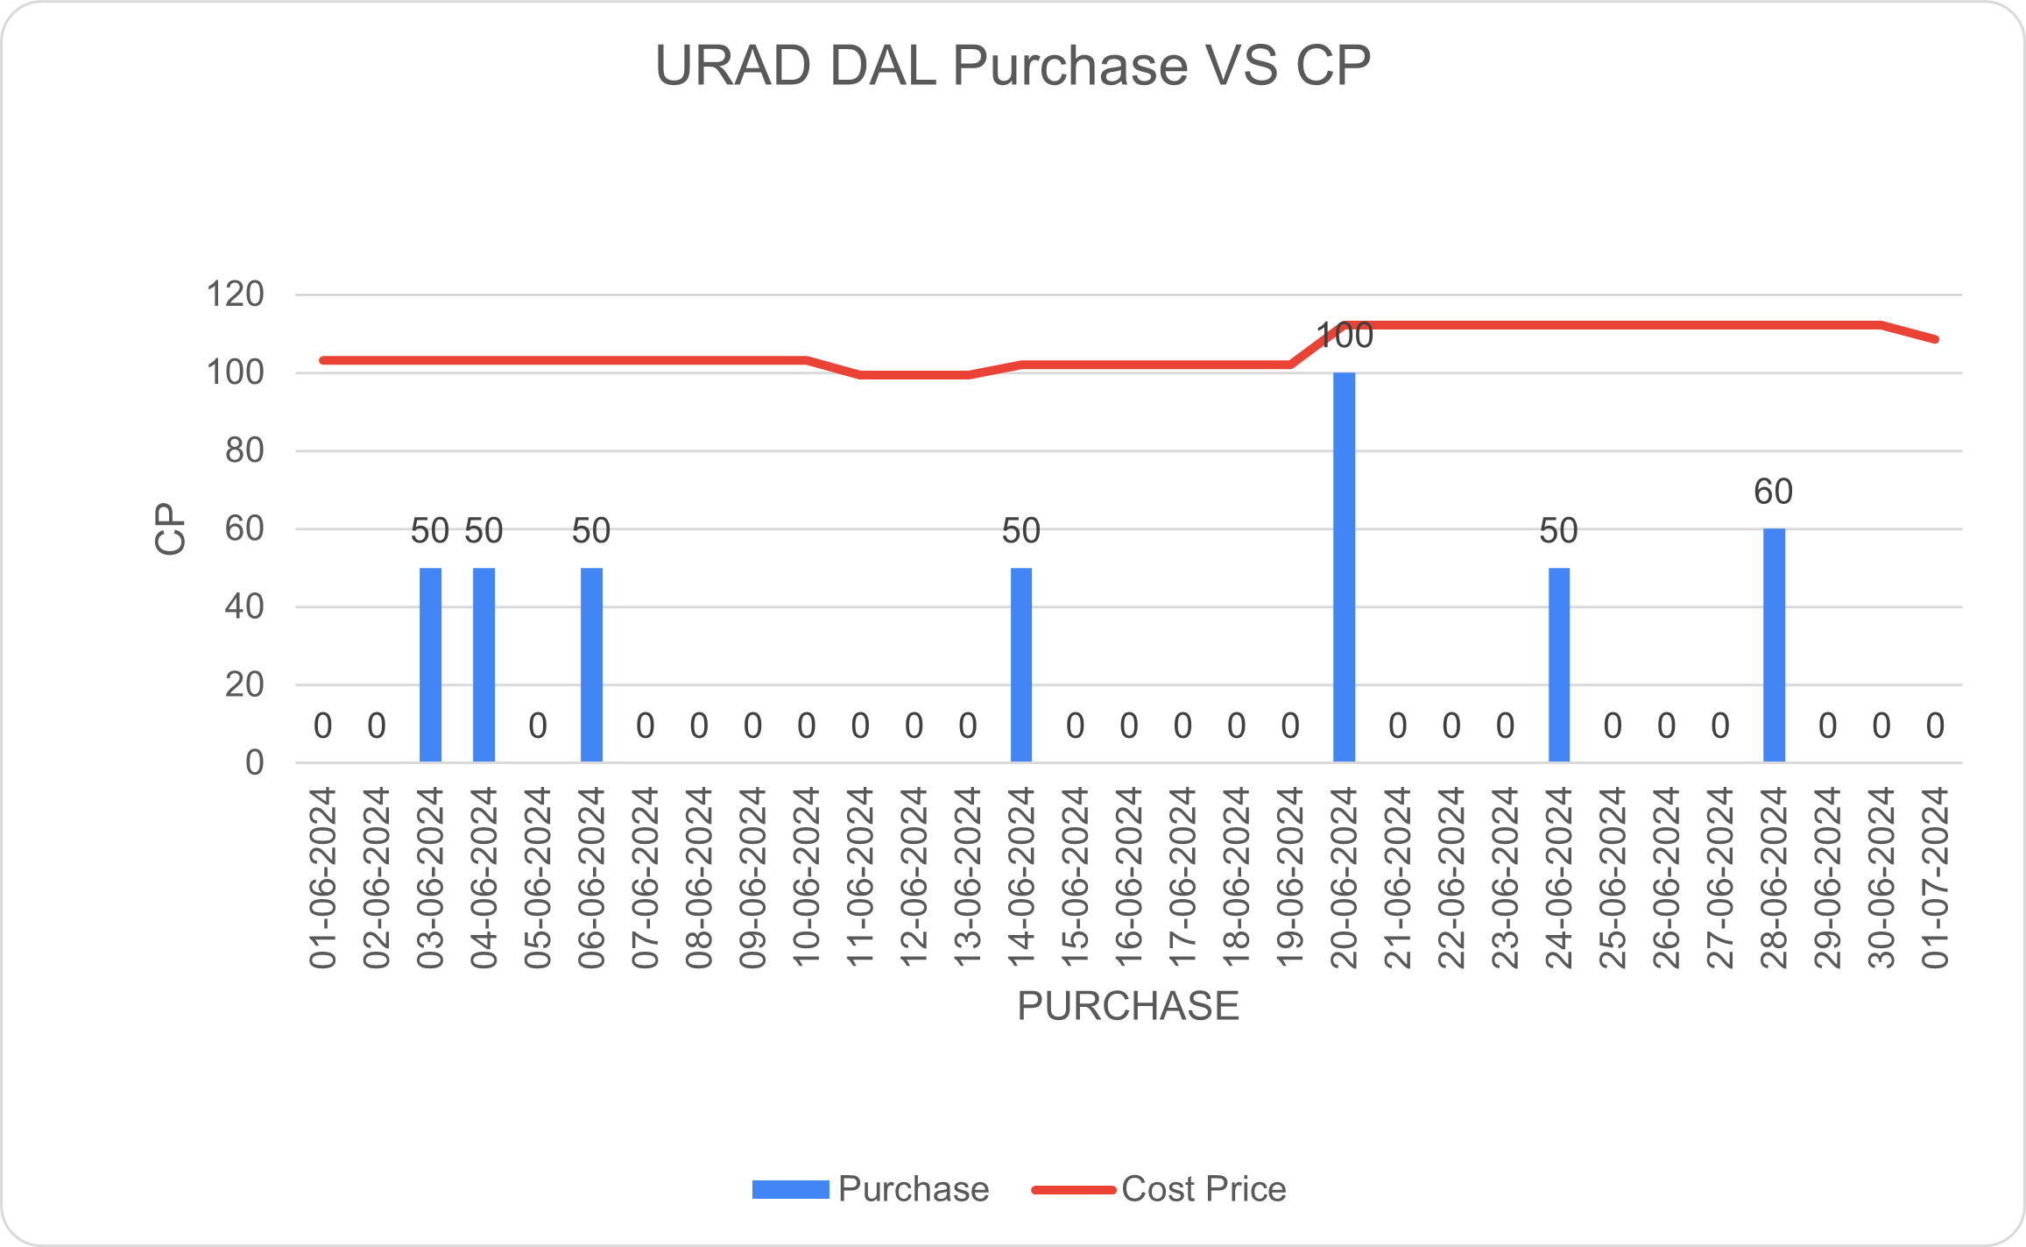
2.Data Analysis
Objective 2 : Purchase
The shop owner made two wrong-timed purchases when prices were at their peak. These transactions led to the seller gaining an extra 10-15 Rs/Kg. This additional cost could have been avoided if the purchases had been made 2-3 days earlier or later.
The data reveals a slight increase in the purchase price for most of the SKUs in the middle of the month, with the following exceptions:
1. Cooking Oil: The purchase price for cooking oil tends to show a decline.
2. Urad Dal: The purchase price for urad dal exhibits a significant increase.

Slide 7
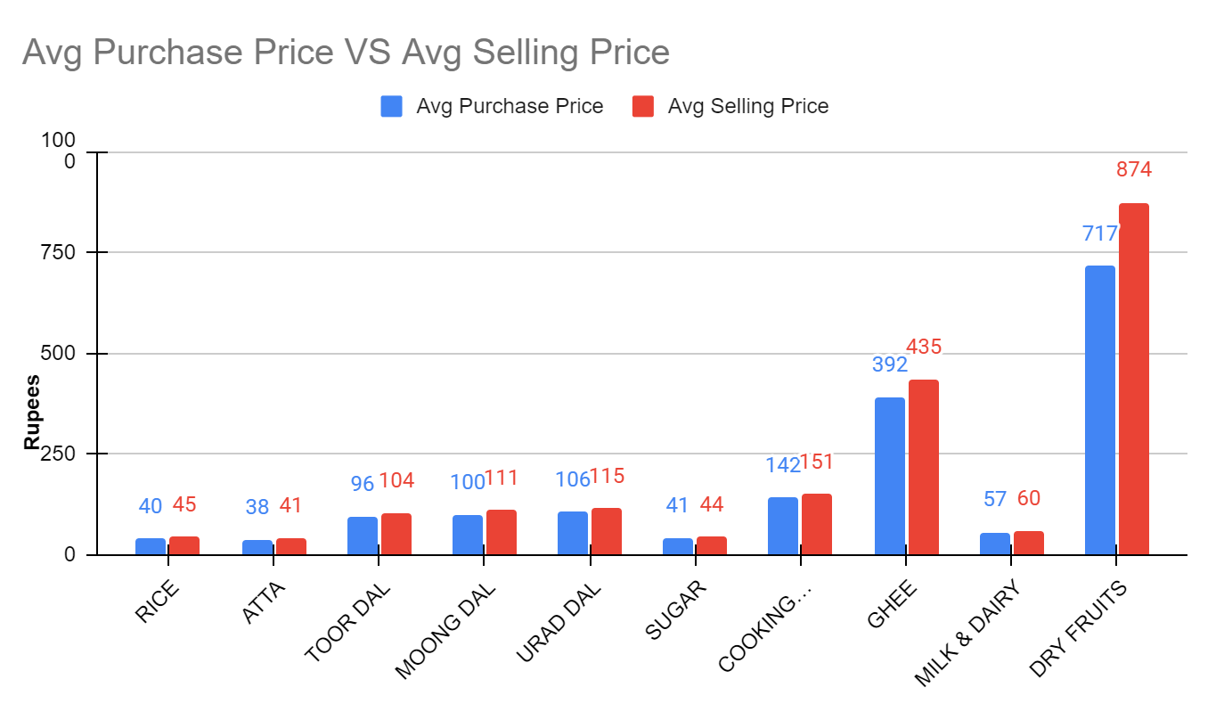
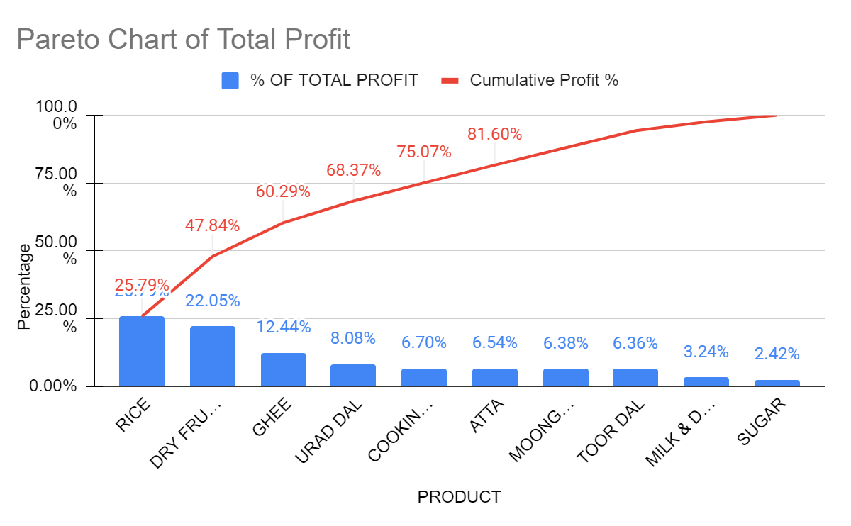
2. Data Analysis
Objective 3 : Profit / Loss
Dry fruits and Ghee are the items that holds maximum profit generating capacity
Rice , Dry Fruits , Ghee , Urad Dal , Cooking OIl and Atta are the 6 SKU contributing to the 81.60% of shop total profit

Slide 8
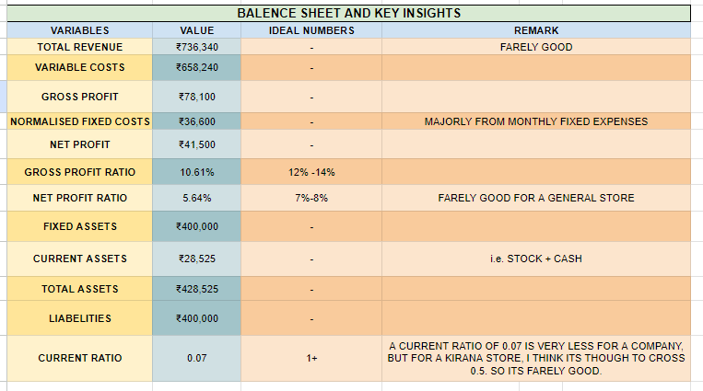
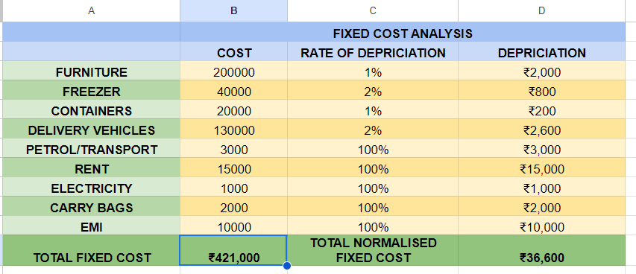
3. Findings (PL & Insights)
𝑁𝑒𝑡 𝑝𝑟𝑜𝑓𝑖𝑡 = 𝐺𝑟𝑜𝑠𝑠 𝑃𝑟𝑜𝑓𝑖𝑡 − 𝑇𝑜𝑡𝑎𝑙 𝑁𝑜𝑟𝑚𝑎𝑙𝑖𝑠𝑒𝑑 𝐹𝑖𝑥𝑒𝑑 𝐶𝑜𝑠𝑡)
= 78,100 − 36,600
Net profit = ₹41,500

Slide 9

4. Final Recommendations
1) Increase the sales of high profit item (such as :- Dry Fruits & Ghee)
2) Increasing Sales of Milk
3) Restock inventory earlier than usual or during high sales periods
4) Increase Current Ratio
6) Enhance Store Display
5) Effective Pricing Strategies

Slide 10
THANK YOU…

